Slide 1


PAAVAI ENGINEERING COLLEGE
(AUTONOMOUS)
NH-44 PAAVAI NAGAR, PACHAL, NAMAKKAL, TAMIL NADU, INDIA.
DEPARTMENT OF INFORMATION TECHNOLOGY
YOGA RECOMMENDATION AND MONITORING SYSTEM
MAIN PROJECT END SEMESTER VIVA VOCE
BATCH NO: 1
GUIDE BY :
BATCH MATES :
Mrs. M.Saranya, M.E
Associate Professor,
Department of Information Technology,
Paavai Engineering College.
DURGADEVI.R, IVth Year IT,
AISHWARYA.S, IVth Year IT,
VIGNESH KUMAR.R,IVth Year IT.

Slide 2

INTRODUCTION
◽Like every exercise,yoga is also more important in our life
◽It is not always possible to have an instructor or to join yoga classes nowadays lifestyles
◽So this system help to identify yoga poses and give feedback and suggestions to users.

Slide 3

OBJECTIVE
The main objective of the project is to provide a recommendation system of yoga postures as per user's input.
Correct yoga instruction has been made more widely available through yoga education and self-learning platforms

Slide 4

ABSTRACT
🔺Yoga pose recognition and correction to provide standardized and appropriate yoga poses.
🔺Incorrect yoga poses can cause serious injuries and long-term complications.
🔺Analyzing human posture can identify and rectify abnormal positions, improving well-being at home

Slide 5

Existing system
◽yoga studio management software platform offers features for only scheduling classes and tracking attendance
◽ providing personalized recommendations based on practitioners.
◽yoga studio management software platform offers features for only scheduling classes and tracking attendance
◽ providing personalized recommendations based on practitioners.

Slide 6
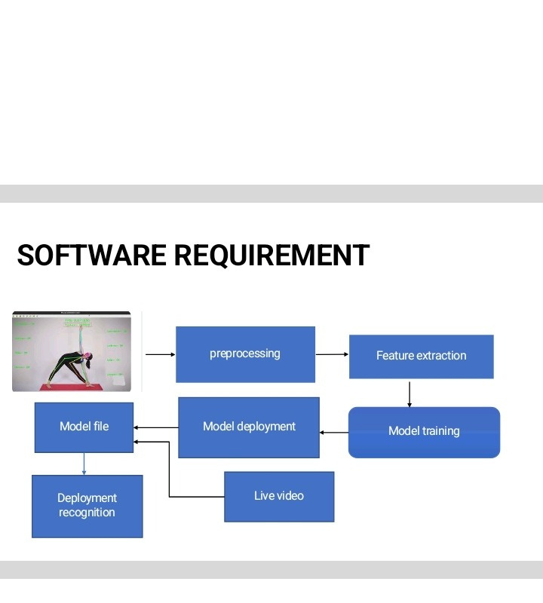
BLOCK DIAGRAM:

Slide 7
PROPOSED SYSTEM
🔹The proposed system takes video sequence frames as input in real time.
🔹 The output would be the predicted yoga pose along with possible feedback for angle and pose correction

Slide 8
SOFTWARE REQUIREMENTS
◽H/W SYSTEM CONFIGURATION:-
Processor - Pentium –IV
RAM - 4 GB (min)
Hard Disk - 20 GB
◽S/W SYSTEM CONFIGURATION:-
Operating System : Windows 10
Frontend : HTML,CSS
backend : PYTHON

Slide 9
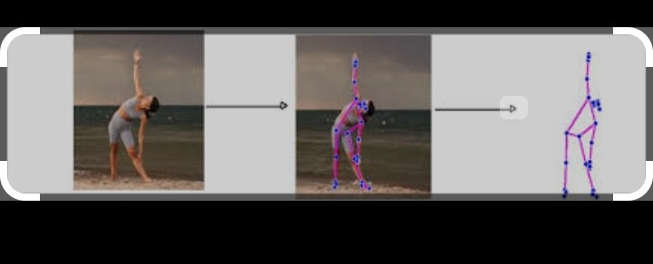
EXAMPLE INPUT AND OUTPUT

Slide 10
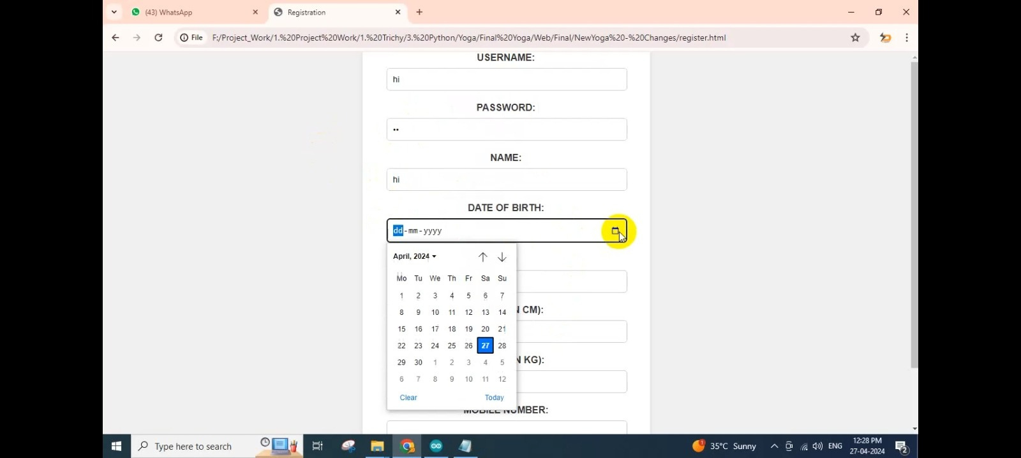
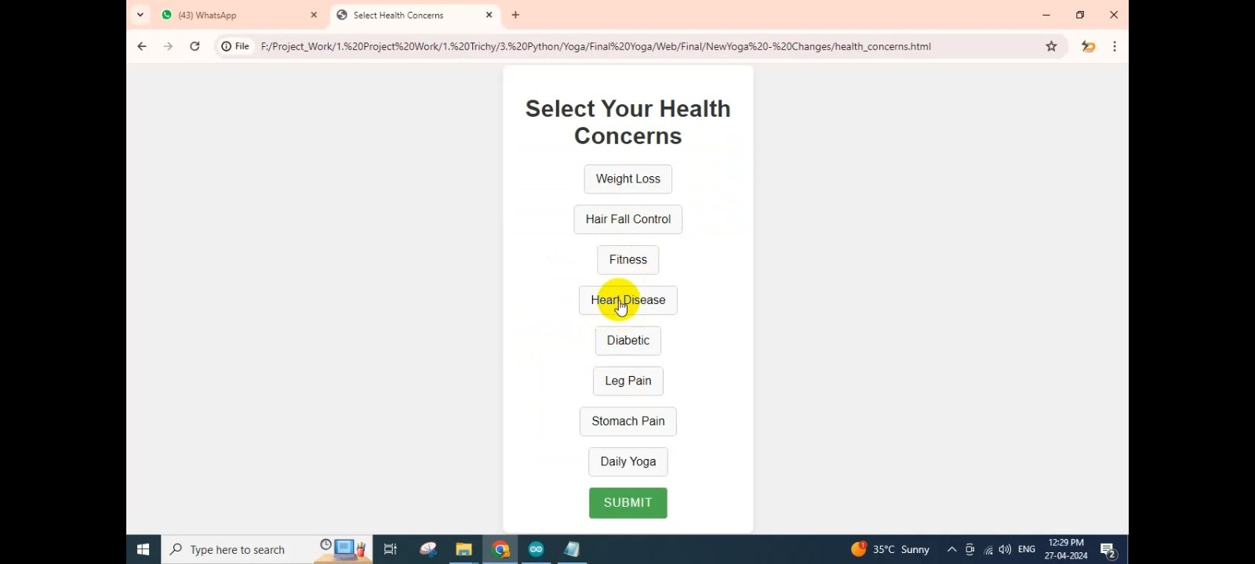
OUTPUT:
STEP: 1
STEP : 2

Slide 11
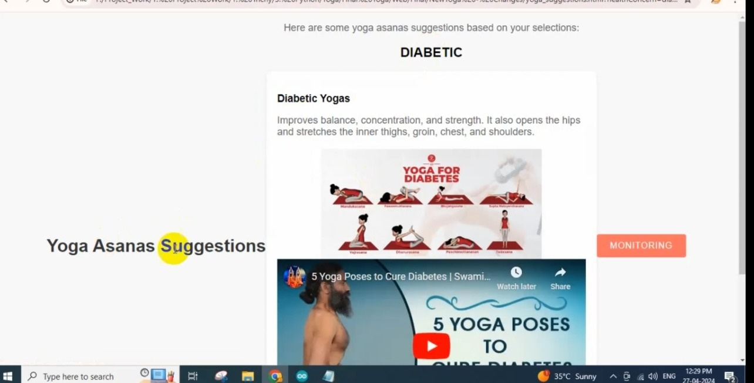
STEP :3

Slide 12
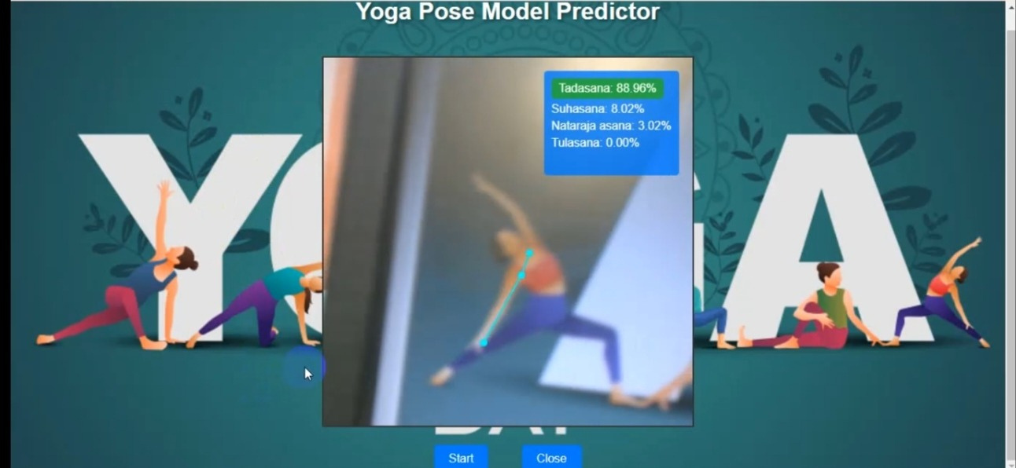
STEP : 4

Slide 13

THANK YOU

